Slide 1






Development of observational tools and coupled models of land-ocean-atmospheric fluxes and exchanges in the Mississippi River watershed and Gulf of Mexico in support of carbon management
Steven Lohrenz (U. Mass Dartmouth)
Wei-Jun Cai (U. Delaware)
Hanqin Tian (Auburn)
Ruoying He (N. Carolina State U.)
Z. George Xue (N. Carolina State U.)
Katja Fennel (Dalhousie)
Stephan Howden (U. Southern Miss.)
Mingliang Liu (Auburn/Washington State U.)
Sumit Chakraborty (U. Mass Dartmouth)
Wei-Jen Huang (U. Georgia)
CMS 2012 Project – CMS Science Team Meeting, November 2014

Slide 2







Acknowledgements
Project was funded through the NASA Carbon Monitoring System program (NNX12AB21G, and NNX12AP84G)
Additional funding, data and cruise support provided by NASA IDS, NSF, NOAA, EPA, and USGS

Slide 3
Overview
Introduction
  Uncertainties in coastal carbon budgets
  Objectives of NASA Carbon Monitoring System Phase 2 Project (2012)
Approach
  Coupled models of land-ocean-atmospheric fluxes and exchanges
  Dynamic Land Ecosystem Model
  Ocean Biogeochemistry Model
Results – Carbon Fluxes and Exchanges
Uncertainty
Products
Next Steps

Slide 4
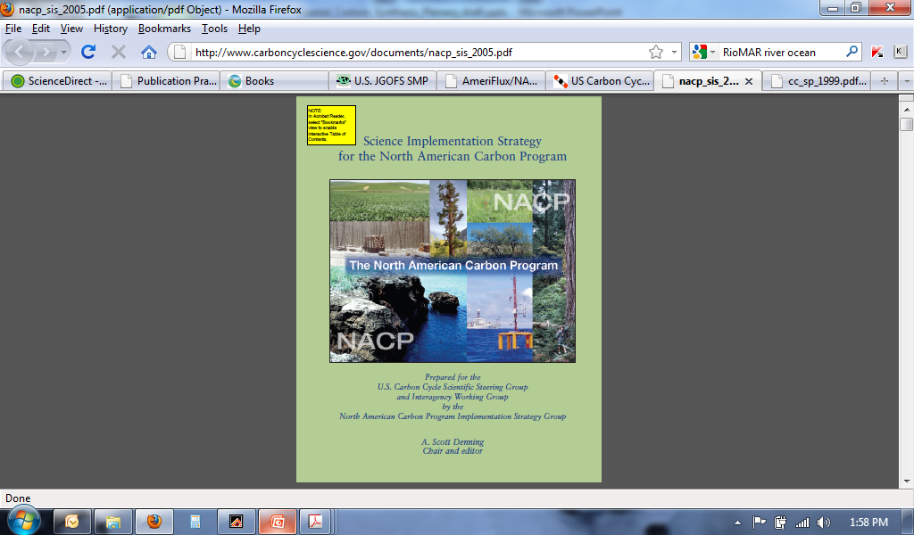
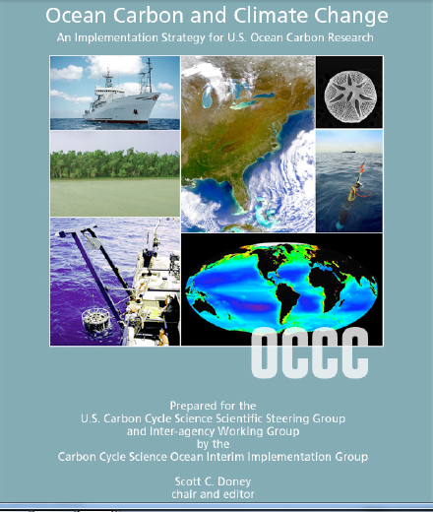
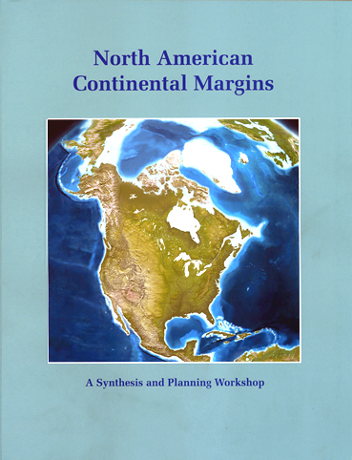
Recognized Importance of Coastal Carbon in Assessing Global Carbon Budgets

Slide 5
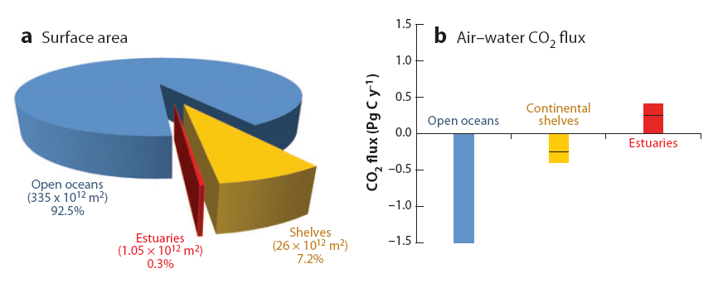
Introduction: Uncertainties in Coastal Carbon Budgets
Carbon fluxes in the coastal margins remain poorly constrained in global carbon budgets, yet contribute disproportionately relative to surface area (Liu et al., 2010; Borges, 2011; Cai, 2011; Chen et al., 2013; Bauer et al., 2013)
Changes in coastal carbon flows and related feedbacks on atmospheric CO₂ are sensitive to 1) coastal physics, 2) changes in terrestrial carbon and nutrient inputs, and 3) ocean acidification (Borges, 2011)
Reductions in uncertainties as well as ability to project changes in carbon fluxes in response to climate- and human-related activities will benefit carbon management efforts
Cai (2011) Ann Rev Mar Sci
Notes:
Include Wanninkhof paper?

Slide 6
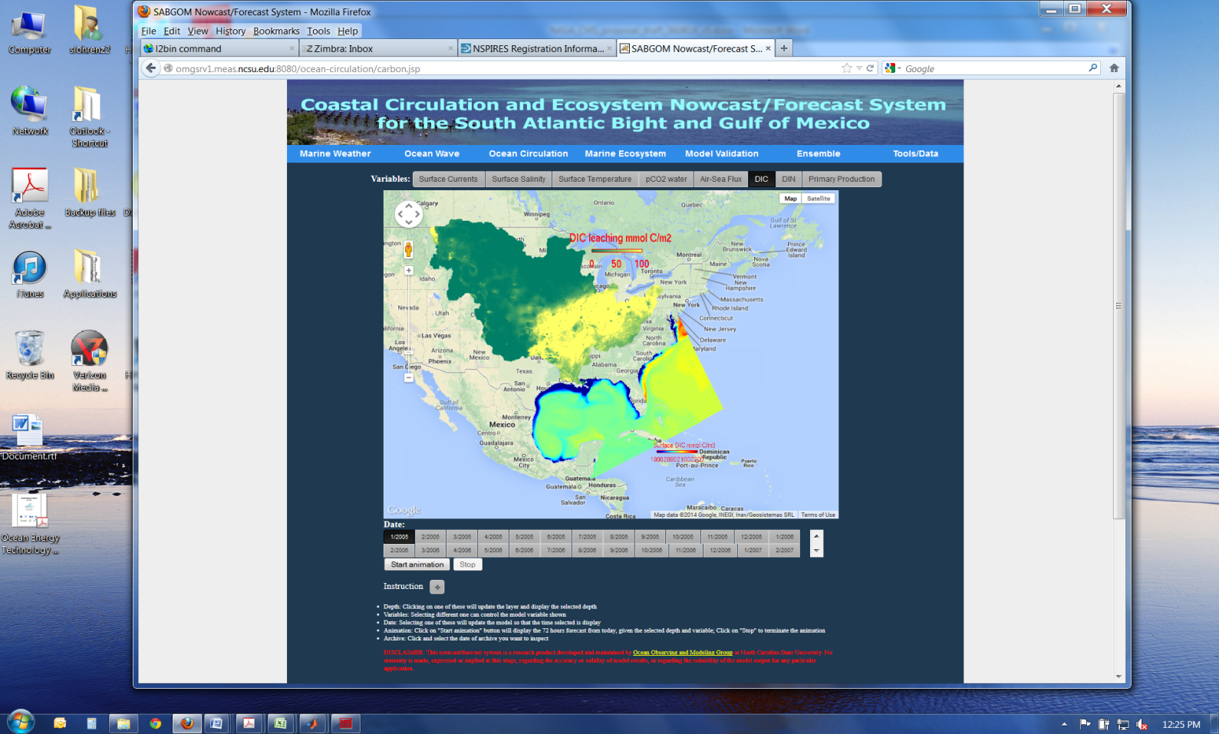
  Project Objectives
Estimation of land‐ocean‐atmosphere carbon and nutrient fluxes and exchanges in the Mississippi River including land-ocean, coastal air-sea, and coastal to open ocean exchanges
Develop observational and modeled geospatial products and associated uncertainties for land, ocean and atmospheric fluxes and exchanges in support of carbon monitoring

Slide 7
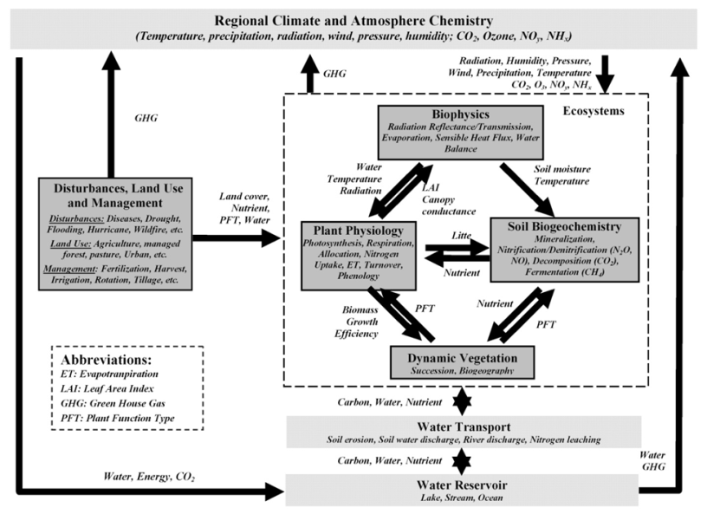
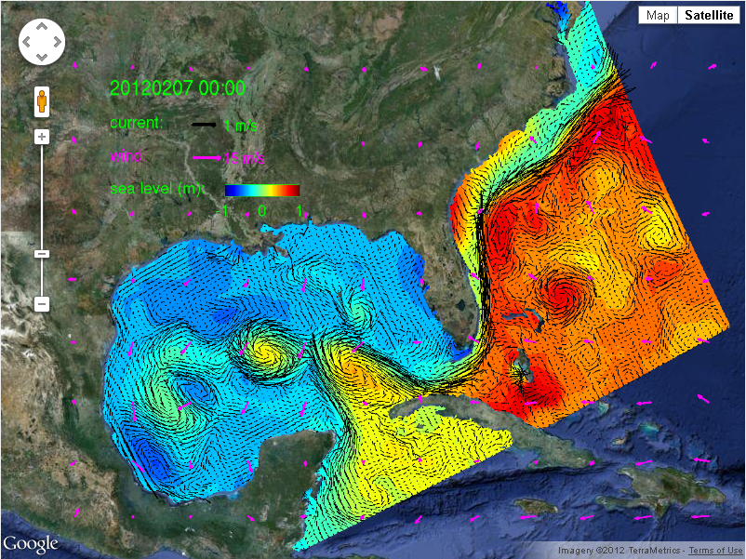
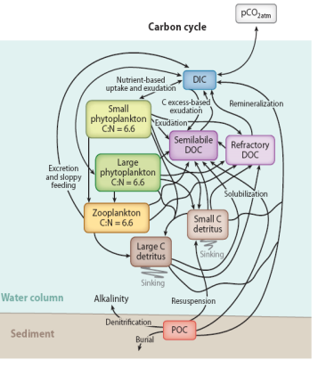
  Approach: Coupled Terrestrial-Ocean Models
DLEM terrestrial outputs linked to a physical-biogeochemical model to characterize coastal carbon fluxes and ecosystem dynamics
Dynamic Land Ecosystem Model used to estimate spatial and temporal patterns of delivery of water, carbon, and nitrogen and compared to data-based observations
Modeling efforts supported by field survey-based and satellite-based observations of carbon fluxes and other biogeochemical processes
Tian et al., 2010a,b; Tian et al.,2011; Tian et al.,2012 ; Zhang et al., 2012
Hyun and He (2010);
Xue et al., 2013, 2014
Hoffman et al., Ann. Rev., 2011;
Fennel et al., 2011, 2013

Slide 8

  Approach: Dynamic Land Ecosystem Model
Tian et al., 2010a,b; Tian et al.,2011, Tian et al.,2012, Tao et al. 2013
Dynamic Land-Ecosystem Model (DLEM2.0)

Slide 9
  Terrestrial Domain: Mississippi-Atchafalaya Basin
The drainage basin for the Mississippi-Atchafalaya river system covers 41% of the conterminous U.S.
Among the ten largest rivers in the world with respect to water and sediment discharge and the largest in the North American continent
Tian et al.
Contemporary land cover distribution across Mississippi-Atchafalaya river basin

Slide 10
DLEM Model Implementation
Assemble terrestrial data sets for model input
Land cover
Historical and projected climate
Land use
Disturbance and regrowth
Manure/fertilizer
Population data
Spatial and temporal patterns of cropland in the Mississippi-Atchafalaya River Basin during 1901-2008 (Tian et al.)

Slide 11
  Model Validation
Validation of DLEM against ground based observations
Tian et al.

Slide 12
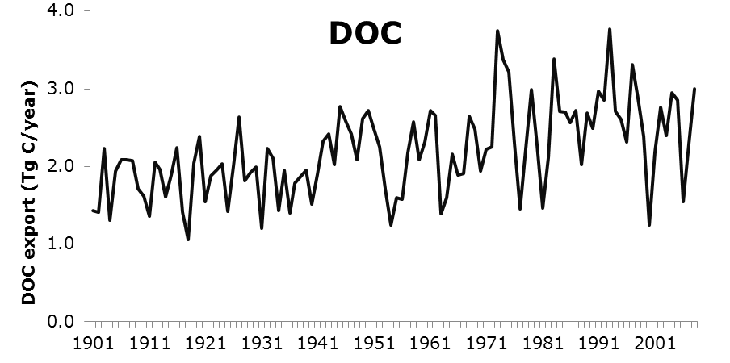
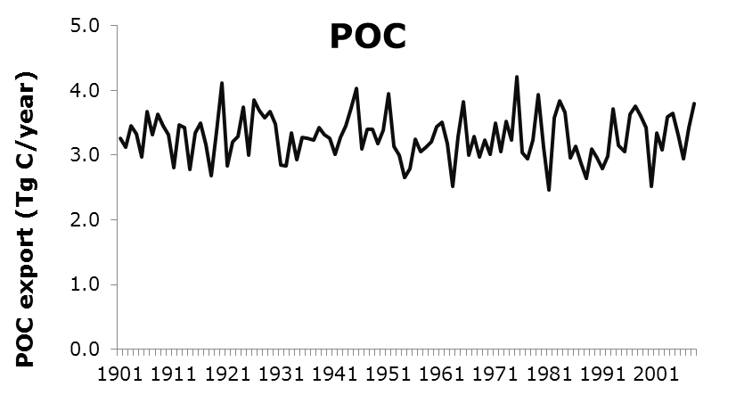
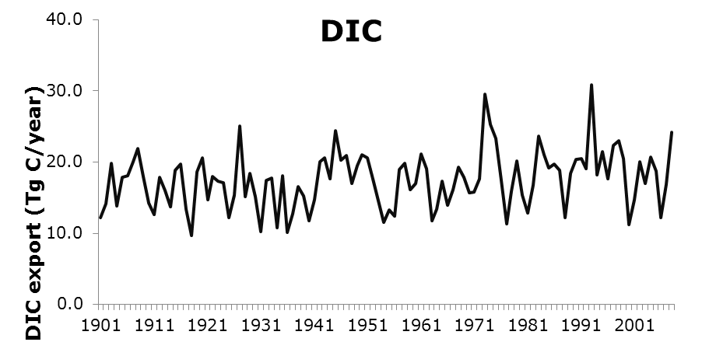
Carbon export
Decadal means of carbon export from MARB
 | DOC | POC | TOC | DIC
(Tg C/year)
1950s | 2.0 | 3.4 | 5.4 | 16.6
1980s | 2.5 | 3.2 | 5.7 | 17.8
1990s | 2.8 | 3.4 | 6.2 | 21.4
2000s | 2.4 | 3.1 | 5.5 | 17.3

Slide 13
Carbon export
Spatial patterns of C
Spatial distribution of yearly total organic carbon (TOC) and dissolved inorganic carbon leaching averaged during 2001-2010

Slide 14
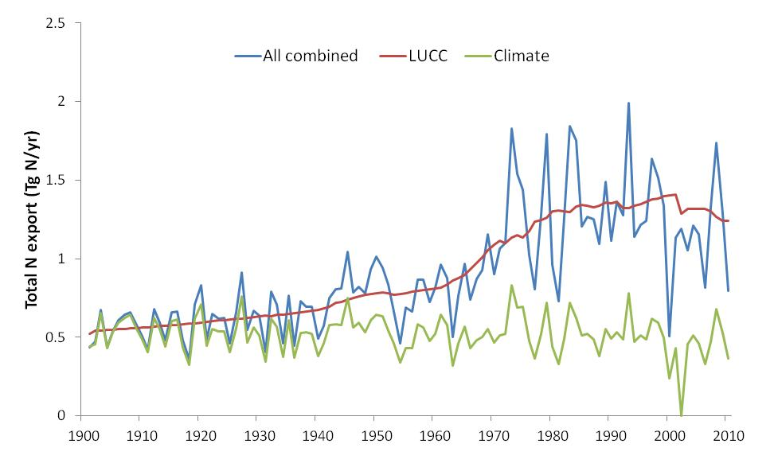
Relative contributions from LUCC and climate
DLEM-simulated total N export (DIN+DON+PON) driven by land use/cover change (LUCC, including land management), climate change and all the environmental changes
Tian et al.

Slide 15
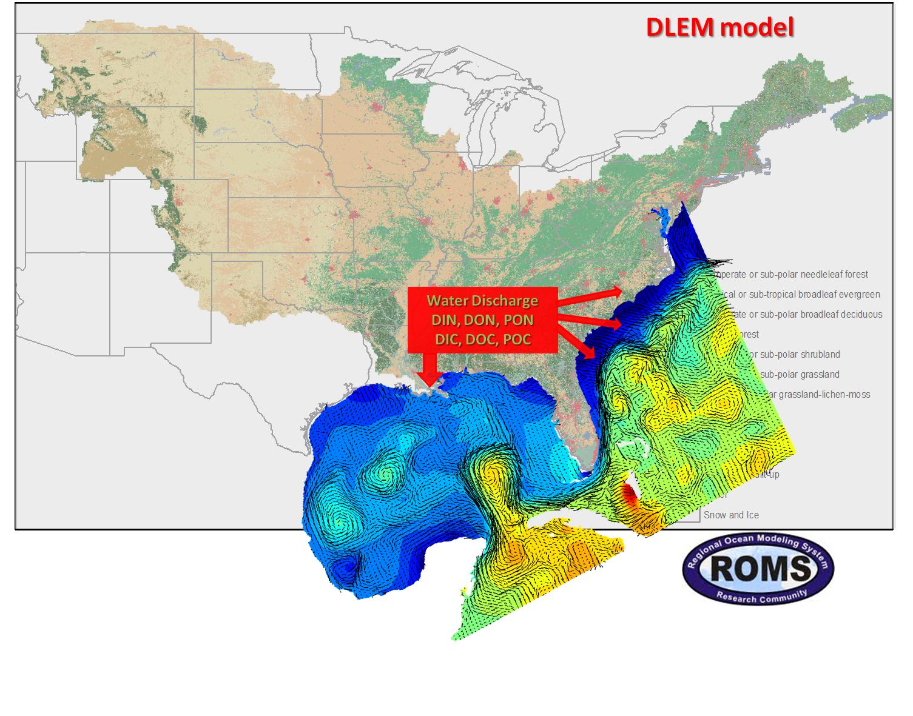
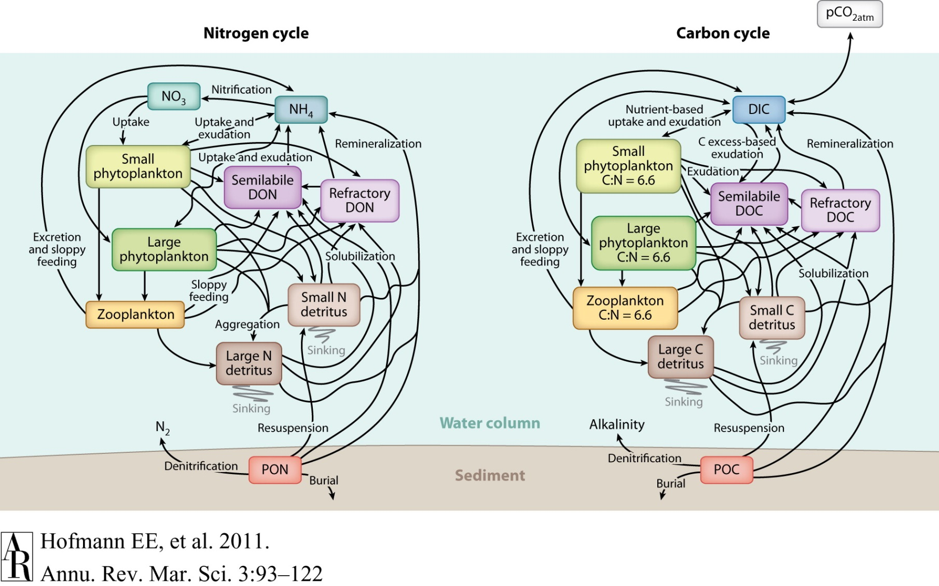
  Approach: SABGOM
Hoffman et al., Ann. Rev., 2011;
Fennel et al., 2011 and in prep.
He et al.
Notes:
SABGOM Ocean Model Setup
• Water Depth: 5 to 5500m (ETOPO2);
• Horizontal Resolution ~ 5 km; Vertical Resolution: 36 layers;
• Tidal forcing: OTPS - 8 tidal constituents;
• Atmospheric Forcing: NARR (3 hr, 1/3 degree)‏;
• Initial, Boundary Conditions: Global HYCOM-NCODA (1/12 degree);
• 63 Rivers (discharge, nutrients, carbon)

Slide 16
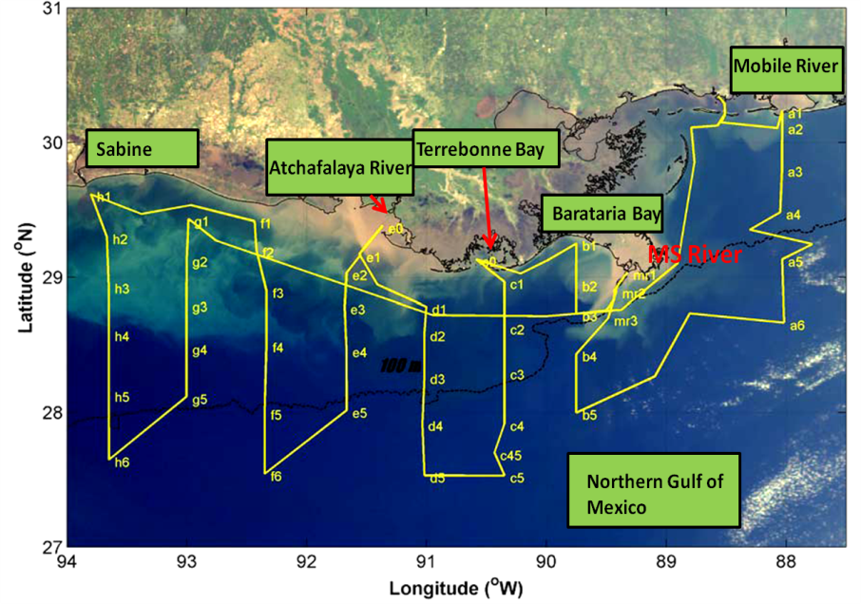
  Ship-based Observations
Data set development: extensive ship-based observations in the northern Gulf of Mexico region from 2003 - 2012
Jun 24-31 2003 | R/V Pelican
Aug 1-8 2004 | R/V Pelican
Oct 3-7 2005 | R/V Pelican
Apr 27 - May 1 2006 | R/V Pelican
Jun 6-11 2006 | OSV Bold (EPA)
Sep 6-11 2006 | OSV Bold (EPA)
Jul 10 - Aug 4 2007 | R/V Brown (NOAA)
May 1-8 2008 | R/V Pelican
31 Oct-7 Nov 2008 | R/V Pelican
Jan 8-20 2009 | R/V Cape Hatteras
Apr 19 - May 1 2009 | R/V Cape Hatteras
July 18 - 30 2009 | R/V Cape Hatteras
Oct 28 - Nov 9 2009 | R/V Sharp
Mar 11-21 2010 | R/V Cape Hatteras
Jul 21 – Aug 13 2012 | R/V Ronald H. Brown
Huang et al., 2012, Biogeosci. and in review
Guo et al., 2012, Limnol. Oceanogr.
Cai et al., 2011, Nature Geosci.
Cai et al., 2011, Ann. Rev. Mar. Sci.
Two Ph.D. dissertations, other papers in prep.
www.gulfcarbon.org

Slide 17
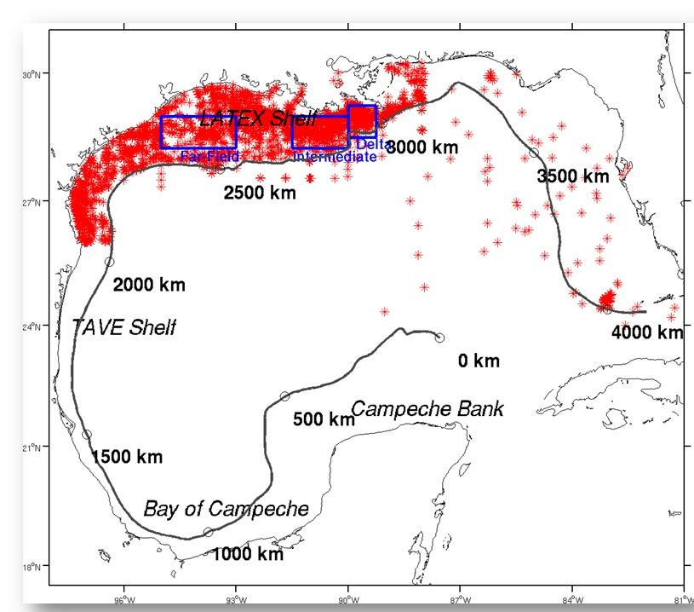
Results
Model refinement and validation
Positions (red dots) of in situ observations and three sub-regions (near field, intermediate, and far field) where area-mean time series comparisons were made. Also shown is 50 m isobath
He, Xue et al.

Slide 18
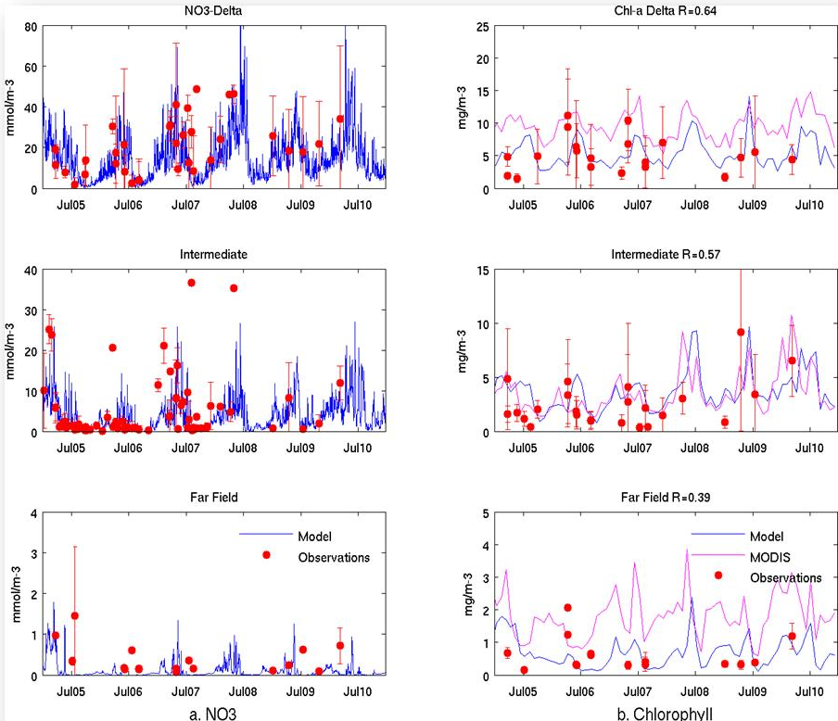
Model Validation
Time series comparisons between observed (red) and simulated (blue) NO3 and chlorophyll in three sub-regions of the northern Gulf
He, Xue et al.

Slide 19
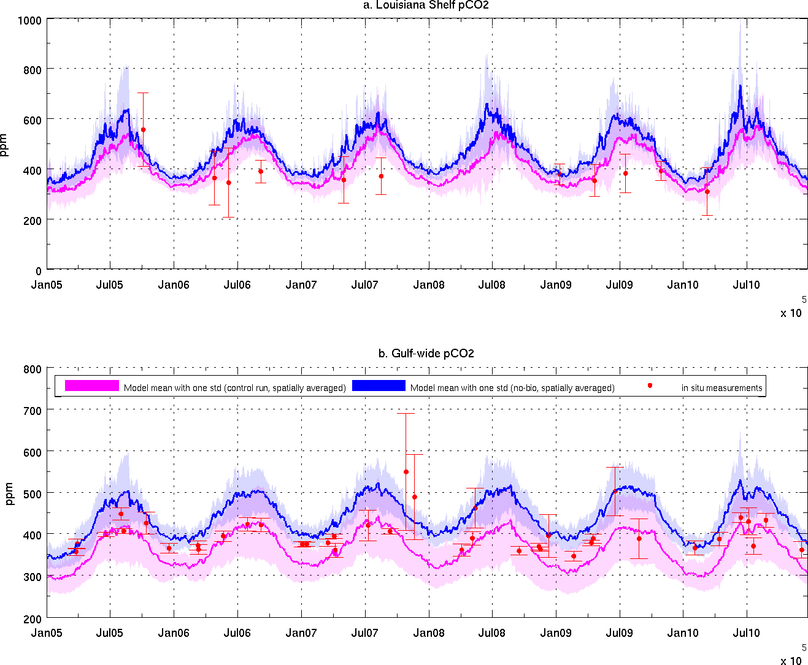
Model Validation
Comparison of model and ship-based pCO₂ observations
Satellite-derived and ship-based pCO₂ estimates
He, Xue et al.

Slide 20
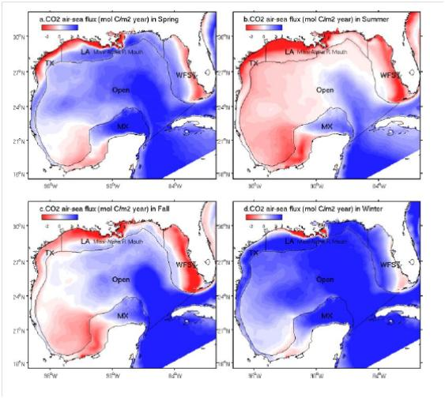
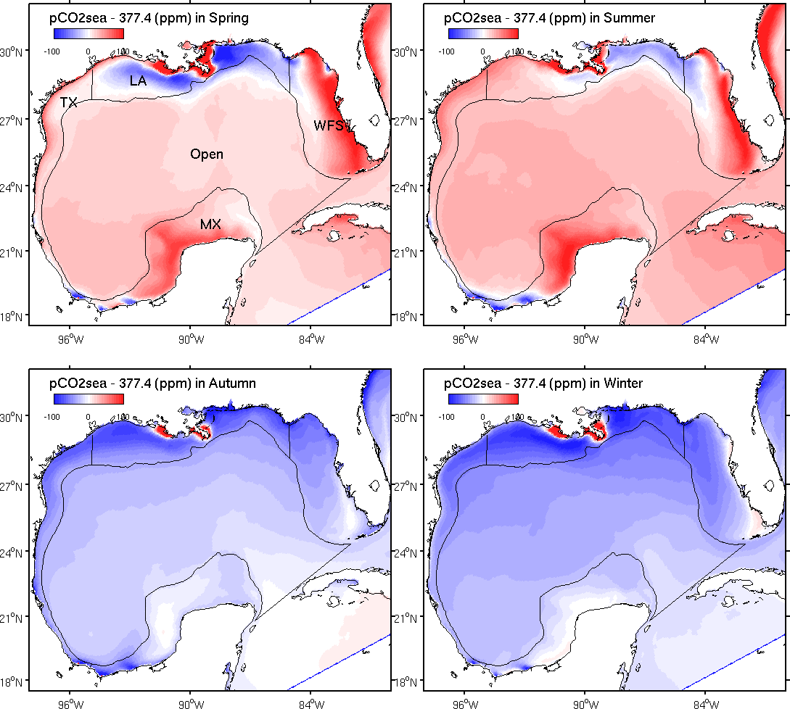
Example of Model Output: Seasonal mean ΔpCO₂ in surface water (ppm)
He, Xue et al.
Fig 4 Model simulated ΔpCO2 (2005-2010 mean) in the Gulf during a) spring, b) summer, c) fall, and d) winter months.

Slide 21
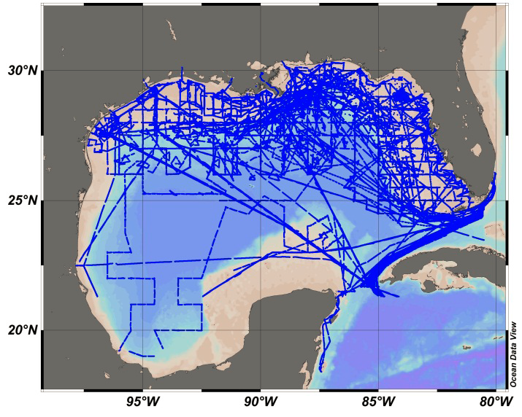
Evaluation of Uncertainty
Courtesy of Wanninkhof and Barbero at NOAA
Region | Mexico Shelf | Texas Shelf | Louisiana Shelf | West Florida Shelf | Open Ocean | Gulf-wide
Model | 1.09 | 0.06 | 0.42 | -0.11 | 1.06 | 0.86
Ship-based | 0.09 | 0.18 | 0.44 | -0.37 | 0.48 | 0.19
Units: mol C m⁻² yr⁻¹; “+” indicates net sink

Slide 22
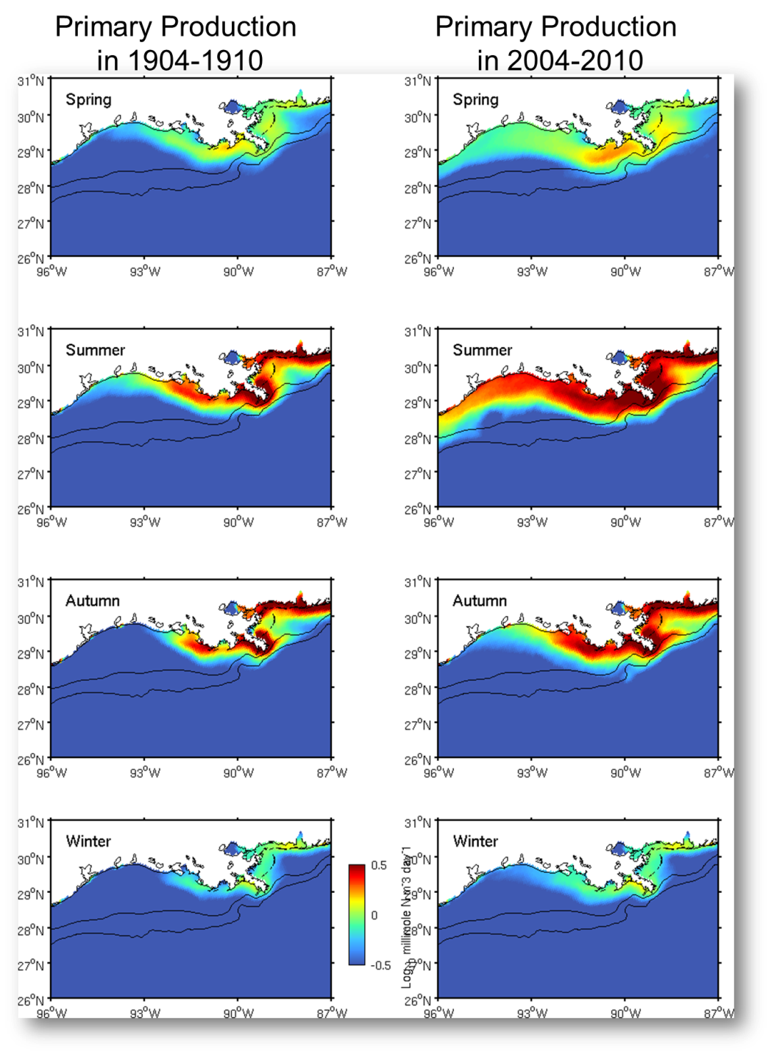
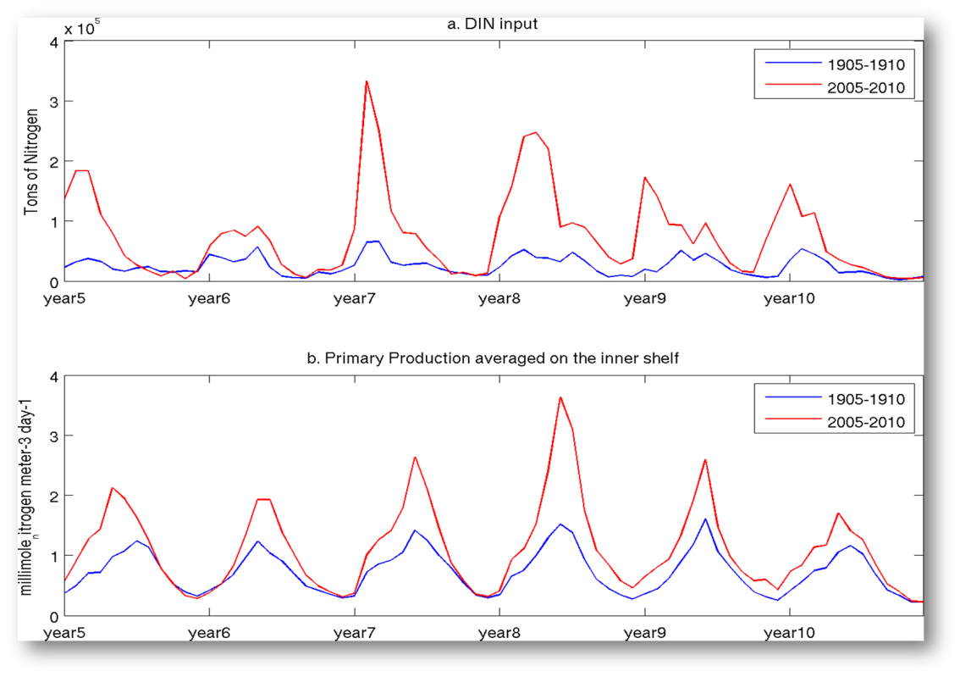
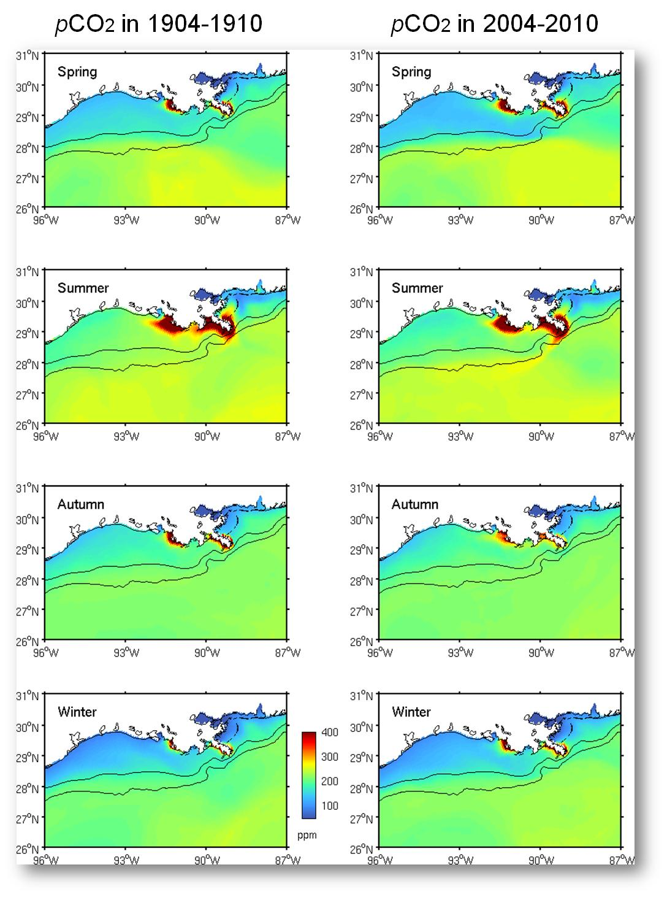
Coupled Model Simulations: 1904-1910 vs. 2004-2010
Increase in DIN export from MARB from 1904-1910 compared to 2004-2010
Significant increase (18%) in ocean primary production

Slide 23
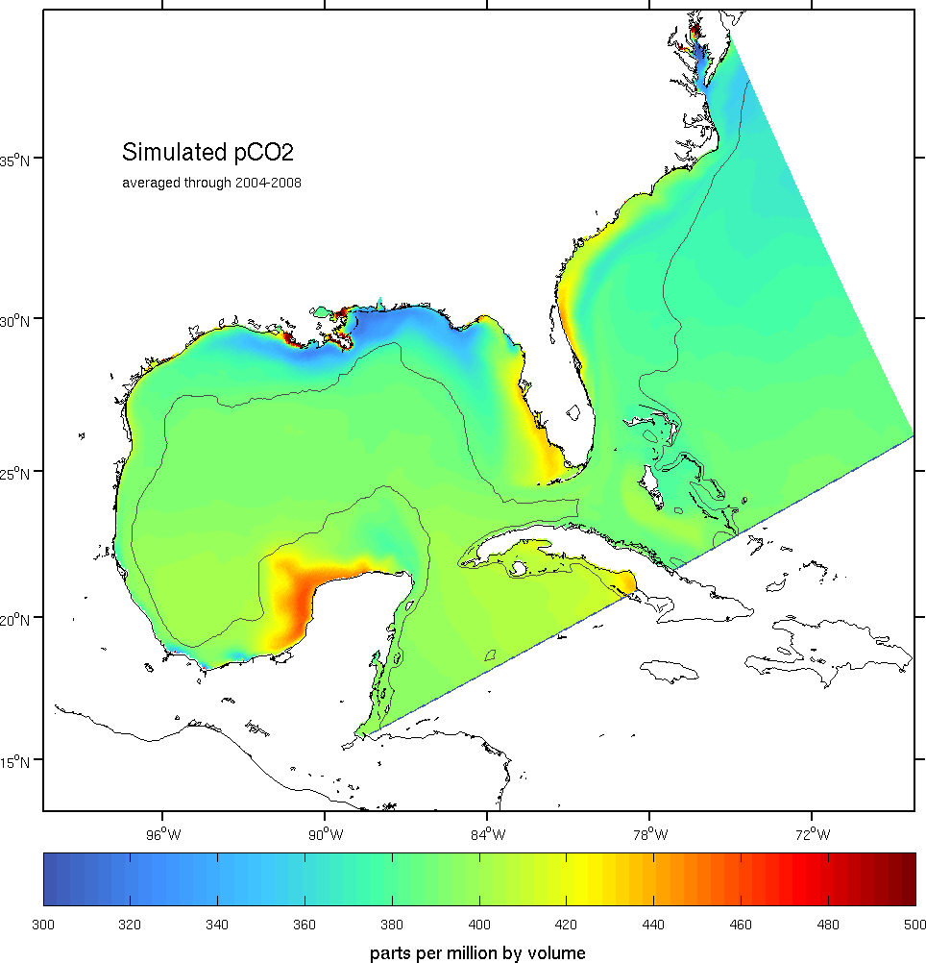
Next Steps
As part of our 2014 project, we will expand the spatial domain of our observational and integrated modeling approach to include both the Mississippi River basin and southeastern U.S., and examine terrestrial carbon storage and fluxes including characterization and quantification of biomass and carbon stocks and land-atmosphere, land-ocean, and sea-atmosphere fluxes of carbon dioxide and methane
Examine different LULUCF scenarios within the terrestrial domain and different climate scenarios to assess effectiveness of carbon management strategies;
Engage with other CMS projects and stakeholders to expand the scope of information provided based on user feedback, and explore possible transition of prototype products to fully operational status

Slide 24
Future Applications
Land
Carbon Management
Land Use Practices
Water and Forest Management
Agriculture, Fertilizer
GHGs
Energy and Biofuels
Development
Model development will provide decision support for issues related to carbon management, water quality, and ecosystem sustainability
River Export
Coastal Margin
Air-sea flux of CO₂
Nutrients and Hypoxia
Ocean Acidification
Wetlands Loss
Coastal Restoration
Water Quality
Fisheries Habitat
Sea Level Rise
Ocean Carbon Reservoir
Long term Sequestration of Carbon?
Export

